Slide 1

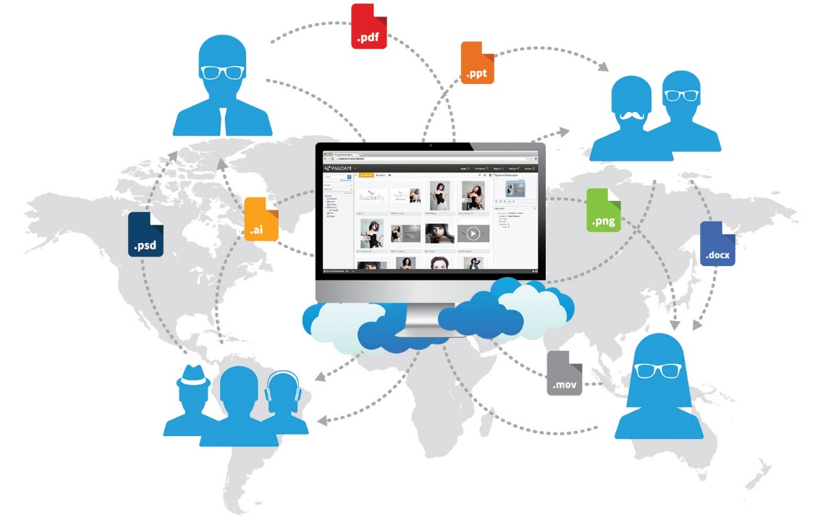


Evaluation Recommendation
Continuous Delivery Tools – Jan 2018
Lead Architect: Pavan Thotireddy Project Manager: Kimberly Willis
Version 1.0
© 2016 AT&T Intellectual Property. All rights reserved. AT&T and the AT&T logo are trademarks of AT&T Intellectual Property. AT&T Proprietary (Internal Use Only). Not for use or disclosure outside the AT&T companies except under written agreement.

Slide 2


One Digital Platform that offers multiple optimized & connected experiences.
Continuous Delivery Tools Recommendation Presentation
PLATFORM
INTERNAL LIFECYCLE TOOLS
ACSI DATA SERVICES
PROCESS
ONGOING HARP
THE DIGITAL ECOSYSTEM
All Assets, All Capabilities
COMMUNICATION
STANDARDS
LABWORX R&D
EDUCATION Digital University
ENGINES
PLATFORM
COMPONENTS
FRAME- WORKS
INFRA- STRUCTURE
2
© 2015 AT&T Intellectual Property. All rights reserved. AT&T and the AT&T logo are trademarks of AT&T Intellectual Property. AT&T Proprietary (Internal Use Only). Not for use or disclosure outside the AT&T companies except under written agreement.

Slide 3
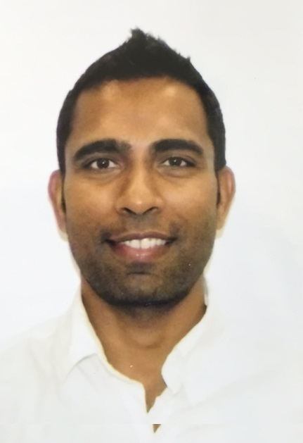

Lead Architect - Pavan Thotireddy
Continuous Delivery Tools Recommendation Presentation
Areas of Expertise:
15 Years of designing & delivering highly scalable & reliable e-Commerce applications:
Disney merchandise e-Commerce site – 3 Years
myAT&T Sales – 10 Years
DevOps Tools & Processes – 4 Years
Major Digital Experience projects:
Wireline Buyflow Consolidation Project
Hardrock Desktop & Mobile for AT&T Mobility
iPhone Iconic launches
DevOps Maturity Model and Application Assessments
CI/CD Tools evaluations
AT&T Experience
AT&T since 2006
Online since 2006
3
© 2015 AT&T Intellectual Property. All rights reserved. AT&T and the AT&T logo are trademarks of AT&T Intellectual Property. AT&T Proprietary (Internal Use Only). Not for use or disclosure outside the AT&T companies except under written agreement.

Slide 4

Agenda
Continuous Delivery Tools Recommendation Presentation
Enabler Scope & Objectives
Evaluation & Selection Approach
Client & Key Stakeholders
Key Capabilities
Test-Drive Use Cases
Products Evaluated
Findings & Analysis
Evaluation Scorecard
Evaluation Summary & Recommendation
Q & A
4
© 2015 AT&T Intellectual Property. All rights reserved. AT&T and the AT&T logo are trademarks of AT&T Intellectual Property. AT&T Proprietary (Internal Use Only). Not for use or disclosure outside the AT&T companies except under written agreement.

Slide 5
Enabler Scope & Objectives
Continuous Delivery Tools Recommendation Presentation
Scope
Evaluate, select and recommend automation and orchestration tools that enable daily delivery of code and defect fixes to production for Digital Experience applications by automating end-to-end process from code check-in, build creation, regression testing, deployment to any environment and release to production, without sacrificing quality
Key Objectives
Ability to streamline and automate build, test, deliver and deploy code to production to help achieve faster, frequent and reliable releases
Reduces the cost for defect fixes through faster defect testing cycle and test automation
Continuous Delivery tools Dashboard view will Improve communication, collaboration, and integration between developers, testers, and operations
Ability to deploy on demand with complete control and transparency of the entire release pipeline
5
© 2015 AT&T Intellectual Property. All rights reserved. AT&T and the AT&T logo are trademarks of AT&T Intellectual Property. AT&T Proprietary (Internal Use Only). Not for use or disclosure outside the AT&T companies except under written agreement.

Slide 6
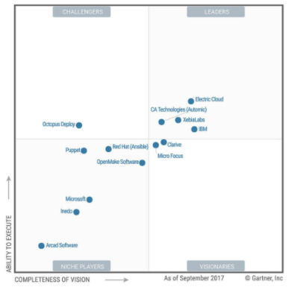
Evaluation & Selection Approach
Continuous Delivery Tools Recommendation Presentation
INSERT CHART
Workshops conducted with Clients & Key Stakeholders:
Defined, categorized and prioritized Enabler key capabilities
Identified test-drive use-cases
Leading products in the market identified based on <Chart Source>, internal knowledge and other industry studies
Deep-dives conducted with leading vendor candidates:
Electric Cloud
Xebia Labs
CA Automic
ATT ECO
Vendor candidates short-listed:
Electric Cloud – Electric Flow: Great product with extensive features
Xebia Labs – XL Deploy & XL Release: Great product but two product required and less K8 support
Products selected after evaluation:
Electric Cloud – Electric Flow
Scorecard created based on prioritized capabilities from Clients & Key Stakeholders
Chart from Gartner on 2017
6
© 2015 AT&T Intellectual Property. All rights reserved. AT&T and the AT&T logo are trademarks of AT&T Intellectual Property. AT&T Proprietary (Internal Use Only). Not for use or disclosure outside the AT&T companies except under written agreement.

Slide 7
Client & Key Stakeholders
Continuous Delivery Tools Recommendation Presentation
Organization / Role | Name
DET Delivery – Leadership | Guy Bevente, Dale Lynn, Mike Morris, Napoleon Sanders
DET Platform Engineering | Manoj Abraham, Caleb Oglesby, Pavan Thotireddy, George Krauss, James Bowerman, Kimberly Willis, David Bates
Consumer - myAT&T Service, OPSS, Zone, Registration, etc. | Clyde Johnson, John Lau, Napoleon Sanders
Consumer - myAT&T Support/eCare, KMS, Search, EDD/EGS & IDM/Profile | Charles Emmons, John Lau, Napoleon Sanders
myAT&T Sales – EDS | Siddi Bondhi, Jeff Lium, Josy Vazquez-Rivera, Darby Stewart, Napoleon Sanders
myAT&T Sales – MDS, CCC | Kyle Bixby, Jeff Lium, Josy Vazquez-Rivera, Darby Stewart, Napoleon Sanders
DTV.com | Sean De La Torre, Andrey Beleshko, Drew Beechum
Strong partnership and collaboration across functional teams.
7
© 2015 AT&T Intellectual Property. All rights reserved. AT&T and the AT&T logo are trademarks of AT&T Intellectual Property. AT&T Proprietary (Internal Use Only). Not for use or disclosure outside the AT&T companies except under written agreement.

Slide 8
Client & Key Stakeholders Cont.
Continuous Delivery Tools Recommendation Presentation
Organization / Role | Name
ABS - BC Service | Darshan Thakkar, Stacie Croft, Deepanshu Shrivastava, Napoleon Sanders
ABS – BC Sales, Premier, Cloud Portal | Kyle Wilson, Venkaiah Mekala, Purushottam Grover, Stacie Croft, Deepanshu Shrivastava, Napoleon Sanders
Platform – CMS, Home Page/Upper Funnel & Portals, etc. | Samira Virani, Vicki Otis, Napoleon Sanders
Platform – OCE, SAPMP, Unlock Portal, DLOSF, Engage, etc. | Sankar Paneerselvam, Napoleon Sanders
Retail Apps – OPUS, SystemX, Phoenix, etc. | Sunil Vallabhaneni
CDI/LabWorx | Cole Orton
Program & Project Management | Cindy Cashen
Strong partnership and collaboration across functional teams.
8
© 2015 AT&T Intellectual Property. All rights reserved. AT&T and the AT&T logo are trademarks of AT&T Intellectual Property. AT&T Proprietary (Internal Use Only). Not for use or disclosure outside the AT&T companies except under written agreement.

Slide 9
Key Capabilities
Continuous Delivery Tools Recommendation Presentation
Capability Category | Key Capabilities
Functional Fit | Workflow Designing & Execution Build Automation and CI Testing Automation Audit
Architecture Fit | Installation and Configurations Integrations using plugins Cloud Support Kubernetes Support Security
Operational Fit | Environment Configuration & Automation Deployment Automaton Incident/Change Management Reporting and Notifications
Company & Licensing Fit | Enterprising Licensing Support Training
9
© 2015 AT&T Intellectual Property. All rights reserved. AT&T and the AT&T logo are trademarks of AT&T Intellectual Property. AT&T Proprietary (Internal Use Only). Not for use or disclosure outside the AT&T companies except under written agreement.

Slide 10
Test-Drive Use Cases
Continuous Delivery Tools Recommendation Presentation
Capability Category | Use Case | Description | % of Key Capabilities
<Capability Category> | <Use Case Name> | <Brief Description> | <%>
<Capability Category> | <Use Case Name> | <Brief Description> | <%>
<Capability Category> | <Use Case Name> | <Brief Description> | <%>
<Capability Category> | <Use Case Name> | <Brief Description> | <%>
<Capability Category> | <Use Case Name> | <Brief Description> | <%>
10
© 2015 AT&T Intellectual Property. All rights reserved. AT&T and the AT&T logo are trademarks of AT&T Intellectual Property. AT&T Proprietary (Internal Use Only). Not for use or disclosure outside the AT&T companies except under written agreement.

Slide 11

Products Evaluated
Continuous Delivery Tools Recommendation Presentation
Product | Supports Mobile First | Licensing Estimates | Current Use in AT&T | Included in Test Drive | Justification
CA Automic/CDD |  |  | Yes (myATT Services) | Yes | CA has been consistently showing up as a leader in the Gartner, Forrester and Ovum reports
Electric Cloud |  |  |  | Yes | Electric Cloud has been featured in both Gartner and Forrester reports as a strong performer and leader in this area
XL Deploy/Release |  |  |  | Yes | Top tools as per Gartner & Ovum Reports
Eco |  |  | Yes (IDP, IDSE, WLL) | Yes | ATT in-house
CURRENT STATE: | Eco is an internally developed tool within AT&T, and is gaining popularity with its CDP integration and Micro services focus. Not all the tools listed are currently used in ATT
PLATFORM GOAL: | Provide the recommendation based on the paper evaluation followed by the test drive.
11
© 2015 AT&T Intellectual Property. All rights reserved. AT&T and the AT&T logo are trademarks of AT&T Intellectual Property. AT&T Proprietary (Internal Use Only). Not for use or disclosure outside the AT&T companies except under written agreement.

Slide 12
Findings & Analysis
Continuous Delivery Tools Recommendation Presentation
CA Automic/CDD
Electric Cloud
XL Deploy/Release
ATT Eco
Pros:
Release, Calendar, Dashboard view available
Kubernetes plugin is available
Automic and CDD both supports workflows
Rollback facility is available
Cons:
ARA only supports on Windows
Kubernetes plugin support is not having extensive features.
DSL support is not available
Less Plugins available
Pros:
Ample plugins available
Continuous Delivery & Release Automation are available within one tool/setup.
Release, Calendar, Dashboard view available
DSL support available
Kubernetes plugin is available
Rollback facility is available
Cons:
No dashboard available for test results.
Agent required for Weblogic/JBOSS deployments.
Pros:
Ample plugins available
Easy customization for plugin, as code is available on Github
Calendar and release options are available
Great support is available
DSL Support is available
Cons:
SSH required to connect
Both XL Release and XL Deploy is required
Complete Kubernetes support is not available
Pros:
ATT in-house, no cost associated.
FREE
Basic structuring of the project with CI/CD is available using ECO templates
ECO Jenkins Or our own Jenkins can be used with ECO
Cons:
This tool is specifically for microservices only.
No release dashboards are available.
Only DSL support, no drag/drop in UI is available for workflows
CONCLUSIONS:
CA Automic- Great product but complex in usage
Xebia Labs – Great support and easy customization but lack in features for K8
Electric Cloud – Great product with better support for K8 and easy to use
ATT ECO – Great for microservices and freely available
12
© 2015 AT&T Intellectual Property. All rights reserved. AT&T and the AT&T logo are trademarks of AT&T Intellectual Property. AT&T Proprietary (Internal Use Only). Not for use or disclosure outside the AT&T companies except under written agreement.

Slide 13
Evaluation Scorecard
Continuous Delivery Tools Recommendation Presentation
Summary:
<Results summary>
SCORE WEIGHTS
BY CATEGORY:
Company & Licensing Fit | <%>
Architectural Fit | <%>
Functional Fit | <%>
Operational Fit | <%>
13
© 2015 AT&T Intellectual Property. All rights reserved. AT&T and the AT&T logo are trademarks of AT&T Intellectual Property. AT&T Proprietary (Internal Use Only). Not for use or disclosure outside the AT&T companies except under written agreement.

Slide 14
Evaluation Scorecard
Continuous Delivery Tools Recommendation Presentation
Add chart from finalized Capability Matrix
Summary:
<Results summary>
SCORE WEIGHTS
BY CATEGORY:
Company & Licensing Fit | <%>
Architectural Fit | <%>
Functional Fit | <%>
Operational Fit | <%>
14
© 2015 AT&T Intellectual Property. All rights reserved. AT&T and the AT&T logo are trademarks of AT&T Intellectual Property. AT&T Proprietary (Internal Use Only). Not for use or disclosure outside the AT&T companies except under written agreement.

Slide 15


Summary & Recommendation
Continuous Delivery Tools Recommendation Presentation
Electric Flow is the recommended selection
ElectricFlow
#1
AT&T evaluation score of <Score>
Better product with ample of features for both monolithic and microservices
Better licensing model and cheaper then other
Great support from the vendor while test drive
#2
Xebia Labs
AT&T evaluation score of <Score>
Great product with great features
Easy customization as plugin code is available on Github
15
© 2015 AT&T Intellectual Property. All rights reserved. AT&T and the AT&T logo are trademarks of AT&T Intellectual Property. AT&T Proprietary (Internal Use Only). Not for use or disclosure outside the AT&T companies except under written agreement.

Slide 16
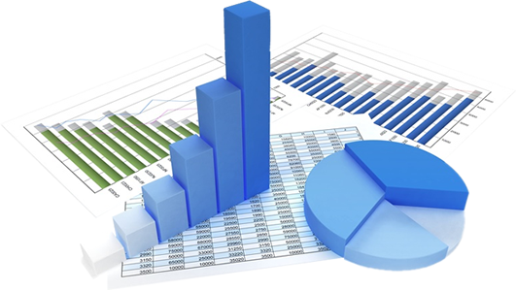
QUESTIONS?
16
© 2015 AT&T Intellectual Property. All rights reserved. AT&T and the AT&T logo are trademarks of AT&T Intellectual Property. AT&T Proprietary (Internal Use Only). Not for use or disclosure outside the AT&T companies except under written agreement.

Slide 17
APPENDIX
17
© 2015 AT&T Intellectual Property. All rights reserved. AT&T and the AT&T logo are trademarks of AT&T Intellectual Property. AT&T Proprietary (Internal Use Only). Not for use or disclosure outside the AT&T companies except under written agreement.

